Slide 1
Data Mining:
Concepts and Techniques
— Slides for Textbook —
— Chapter 9 —
©Jiawei Han and Micheline Kamber
Department of Computer Science
University of Illinois at Urbana-Champaign
www.cs.uiuc.edu/~hanj

Slide 2
Chapter 9. Mining Complex Types of Data
Mining spatial databases
Mining multimedia databases
Mining time-series and sequence data
Mining stream data
Mining text databases
Mining the World-Wide Web
Summary

Slide 3
Spatial Data Warehousing
Spatial data warehouse: Integrated, subject-oriented, time-variant, and nonvolatile spatial data repository
Spatial data integration: a big issue
  Structure-specific formats (raster- vs. vector-based, OO vs. relational models, different storage and indexing, etc.)
  Vendor-specific formats (ESRI, MapInfo, Integraph, IDRISI, etc.)
  Geo-specific formats (geographic vs. equal area projection, etc.)
Spatial data cube: multidimensional spatial database
  Both dimensions and measures may contain spatial components

Slide 4
Dimensions and Measures in Spatial Data Warehouse
Dimensions
  non-spatial
    e.g. “25-30 degrees” generalizes to“hot” (both are strings)
  spatial-to-nonspatial
    e.g. Seattle generalizes to description “Pacific Northwest” (as a string)
  spatial-to-spatial
    e.g. Seattle generalizes to Pacific Northwest (as a spatial region)
Measures
  numerical (e.g. monthly revenue of a region)
    distributive (e.g. count, sum)
    algebraic (e.g. average)
    holistic (e.g. median, rank)
  spatial
    collection of spatial pointers (e.g. pointers to all regions with temperature of 25-30 degrees in July)

Slide 5
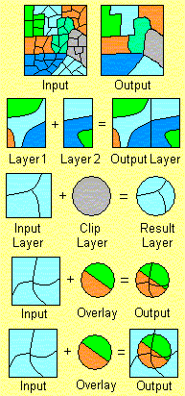
Spatial-to-Spatial Generalization
Generalize detailed geographic points into clustered regions, such as businesses, residential, industrial, or agricultural areas, according to land usage
Requires the merging of a set of geographic areas by spatial operations
Dissolve
Merge
Clip
Intersect
Union

Slide 6
Example: British Columbia Weather Pattern Analysis
Input
  A map with about 3,000 weather probes scattered in B.C.
  Daily data for temperature, precipitation, wind velocity, etc.
  Data warehouse using star schema
Output
  A map that reveals patterns: merged (similar) regions
Goals
  Interactive analysis (drill-down, slice, dice, pivot, roll-up)
  Fast response time
  Minimizing storage space used
Challenge
  A merged region may contain hundreds of “primitive” regions (polygons)

Slide 7
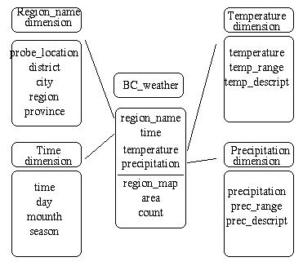
Star Schema of the BC Weather Warehouse
Spatial data warehouse
  Dimensions
    region_name
    time
    temperature
    precipitation
  Measurements
    region_map
    area
    count
Dimension table
Fact table

Slide 8
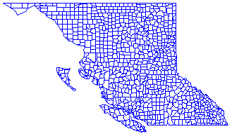
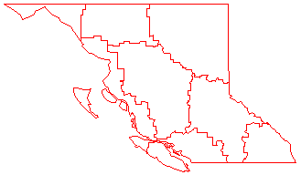
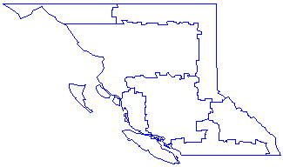
Dynamic Merging of Spatial Objects
Materializing (precomputing) all?—too much storage space
On-line merge?—slow, expensive
Precompute rough approximations?—accuracy trade off
A better way: object-based, selective (partial) materialization

Slide 9
Methods for Computing Spatial Data Cubes
On-line aggregation: collect and store pointers to spatial objects in a spatial data cube
  expensive and slow, need efficient aggregation techniques
Precompute and store all the possible combinations
  huge space overhead
Precompute and store rough approximations in a spatial data cube
  accuracy trade-off
Selective computation: only materialize those which will be accessed frequently
  a reasonable choice

Slide 10
Spatial Association Analysis
Spatial association rule: A ⇒ B [s%, c%]
  A and B are sets of spatial or non-spatial predicates
    Topological relations: intersects, overlaps, disjoint, etc.
    Spatial orientations: left_of, west_of, under, etc.
    Distance information: close_to, within_distance, etc.
  s% is the support and c% is the confidence of the rule
Examples
1) is_a(x, large_town) ^ intersect(x, highway) → adjacent_to(x, water)
[7%, 85%]
2) What kinds of objects are typically located close to golf courses?

Slide 11
Progressive Refinement Mining of Spatial Association Rules
Hierarchy of spatial relationship:
  g_close_to: near_by, touch, intersect, contain, etc.
  First search for rough relationship and then refine it
Two-step mining of spatial association:
  Step 1: Rough spatial computation (as a filter)
    Using MBR or R-tree for rough estimation
  Step2: Detailed spatial algorithm (as refinement)
    Apply only to those objects which have passed the rough spatial association test (no less than min_support)

Slide 12
Spatial Classification
Analyze spatial objects to derive classification schemes, such as decision trees, in relevance to certain spatial properties (district, highway, river, etc.)
  Classifying medium-size families according to income, region, and infant mortality rates
  Mining for volcanoes on Venus
Employ most of the methods in Chapter 7
  Decision-tree classification, Naïve-Bayesian classifier + boosting, neural network, genetic programming, etc.
  Association-based multi-dimensional classification - Example: classifying house value based on proximity to lakes, highways, mountains, etc.

Slide 13
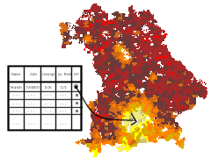
Spatial Trend Analysis
Function
  Detect changes and trends along a spatial dimension
  Study the trend of non-spatial or spatial data changing with space
Application examples
  Observe the trend of changes of the climate or vegetation with increasing distance from an ocean
  Crime rate or unemployment rate change with regard to city geo-distribution

Slide 14
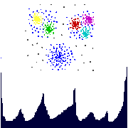
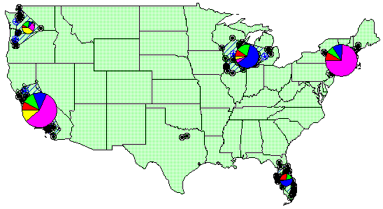
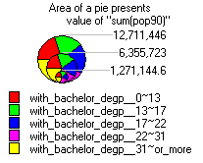
Spatial Cluster Analysis
Mining clusters—k-means, k-medoids, hierarchical, density-based, etc.
Analysis of distinct features of the clusters

Slide 15
Constraints-Based Clustering
Constraints on individual objects
  Simple selection of relevant objects before clustering
Clustering parameters as constraints
  K-means, density-based: radius, min-# of points
Constraints specified on clusters using SQL aggregates
  Sum of the profits in each cluster > $1 million
Constraints imposed by physical obstacles
  Clustering with obstructed distance

Slide 16
Constraint-Based Clustering: Planning ATM Locations
C3
C2
Bridge
C1
River
Mountain
C4
Spatial data with obstacles
Clustering without taking
obstacles into consideration

Slide 17
Chapter 9. Mining Complex Types of Data
Mining spatial databases
Mining multimedia databases
Mining time-series and sequence data
Mining stream data
Mining text databases
Mining the World-Wide Web
Summary

Slide 18
Similarity Search in Multimedia Data
Description-based retrieval systems
  Build indices and perform object retrieval based on image descriptions, such as keywords, captions, size, and time of creation
  Labor-intensive if performed manually
  Results are typically of poor quality if automated
Content-based retrieval systems
  Support retrieval based on the image content, such as color histogram, texture, shape, objects, and wavelet transforms

Slide 19
Queries in Content-Based Retrieval Systems
Image sample-based queries
  Find all of the images that are similar to the given image sample
  Compare the feature vector (signature) extracted from the sample with the feature vectors of images that have already been extracted and indexed in the image database
Image feature specification queries
  Specify or sketch image features like color, texture, or shape, which are translated into a feature vector
  Match the feature vector with the feature vectors of the images in the database

Slide 20
Approaches Based on Image Signature
Color histogram-based signature
  The signature includes color histograms based on color composition of an image regardless of its scale or orientation
  No information about shape, location, or texture
  Two images with similar color composition may contain very different shapes or textures, and thus could be completely unrelated in semantics
Multifeature composed signature
  Define different distance functions for color, shape, location, and texture, and subsequently combine them to derive the overall result.

Slide 21
Wavelet Analysis
Wavelet-based signature
  Use the dominant wavelet coefficients of an image as its signature
  Wavelets capture shape, texture, and location information in a single unified framework
  Improved efficiency and reduced the need for providing multiple search primitives
  May fail to identify images containing similar in location or size objects
Wavelet-based signature with region-based granularity
  Similar images may contain similar regions, but a region in one image could be a translation or scaling of a matching region in the other
  Compute and compare signatures at the granularity of regions, not the entire image

Slide 22
Wavelet Analysis
Wavelet-based signature
  Use the dominant wavelet coefficients of an image as its signature
  Wavelets capture shape, texture, and location information in a single unified framework
  Improved efficiency and reduced the need for providing multiple search primitives
  May fail to identify images containing similar objects that are in different locations.

Slide 23
One Signature for the Entire Image?
Walnus: [NRS99] by Natsev, Rastogi, and Shim
Similar images may contain similar regions, but a region in one image could be a translation or scaling of a matching region in the other
Wavelet-based signature with region-based granularity
  Define regions by clustering signatures of windows of varying sizes within the image
  Signature of a region is the centroid of the cluster
  Similarity is defined in terms of the fraction of the area of the two images covered by matching pairs of regions from two images

Slide 24
Multidimensional Analysis of Multimedia Data
Multimedia data cube
  Design and construction similar to that of traditional data cubes from relational data
  Contain additional dimensions and measures for multimedia information, such as color, texture, and shape
The database does not store images but their descriptors
  Feature descriptor: a set of vectors for each visual characteristic
    Color vector: contains the color histogram
    MFC (Most Frequent Color) vector: five color centroids
    MFO (Most Frequent Orientation) vector: five edge orientation centroids
  Layout descriptor: contains a color layout vector and an edge layout vector

Slide 25
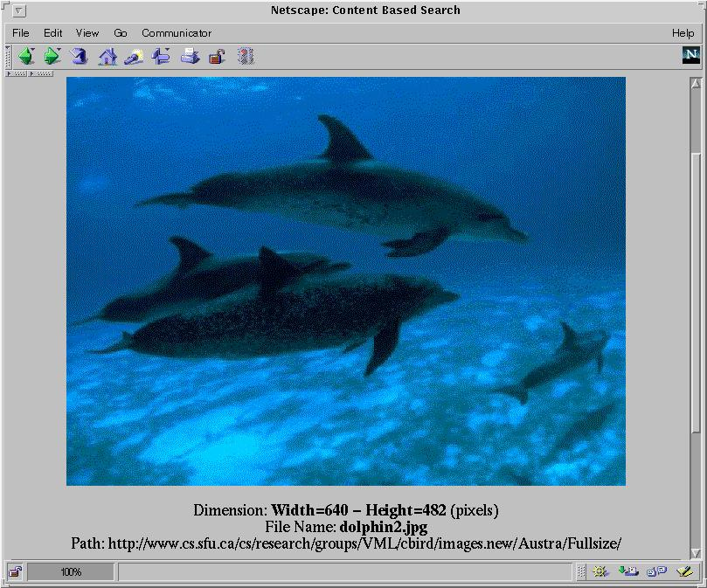
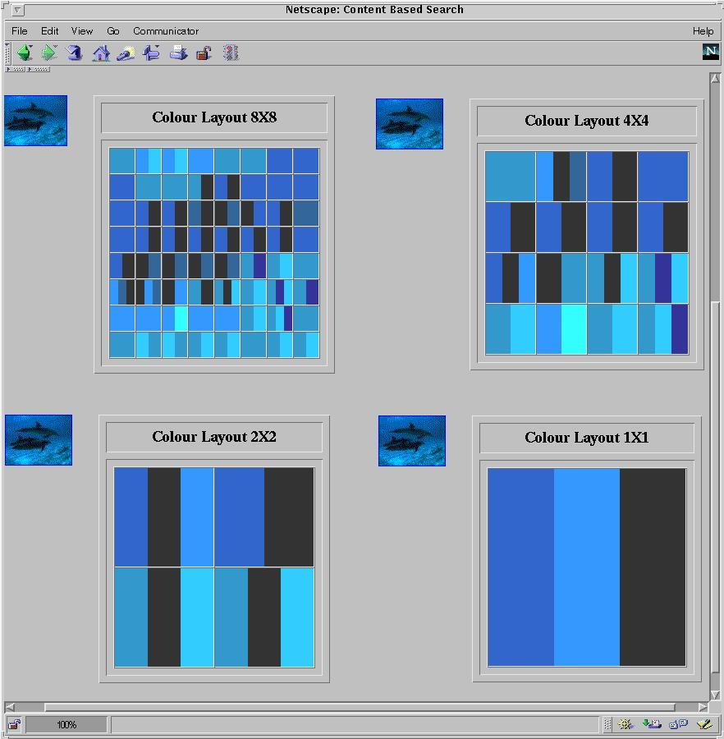
Multi-Dimensional Search in Multimedia Databases
Color layout

Slide 26
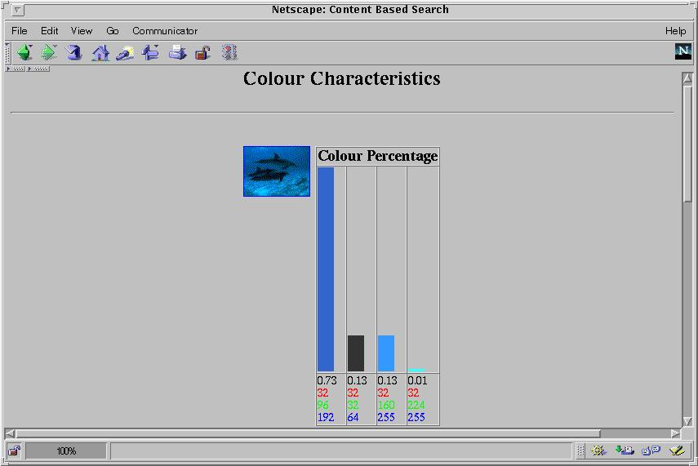
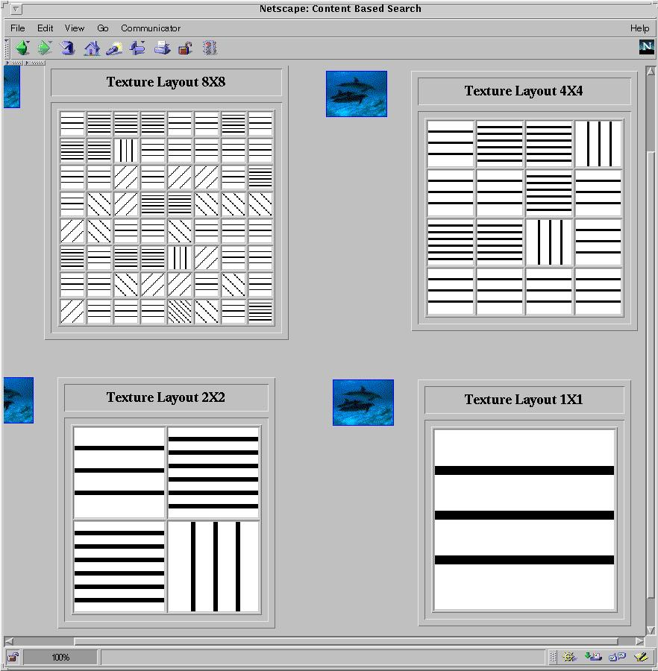
Multi-Dimensional Analysis in Multimedia Databases
Color histogram
Texture layout

Slide 27



Mining Multimedia Databases
Refining or combining searches
Search for “airplane in blue sky”
(top layout grid is blue and
keyword = “airplane”)
Search for “blue sky and
green meadows”
(top layout grid is blue
and bottom is green)
Search for “blue sky”
(top layout grid is blue)

Slide 28

Mining Multimedia Databases
Three Dimensions
The Data Cube and
the Sub-Space Measurements
JPEG
GIF
Small
Medium
Large
Very Large
Two Dimensions
By Size
By Format
By Format & Size
RED
WHITE
Cross Tab
BLUE
By Colour
By Colour & Size
By Format & Colour
JPEG
GIF
RED
Sum
By Colour
WHITE
BLUE
Format of image
Duration
Colors
Textures
Keywords
Size
Width
Height
Internet domain of image
Internet domain of parent pages
Image popularity
Group By
By Format
Colour
Sum
RED
WHITE
BLUE
Dimensions
Measurement
Sum

Slide 29
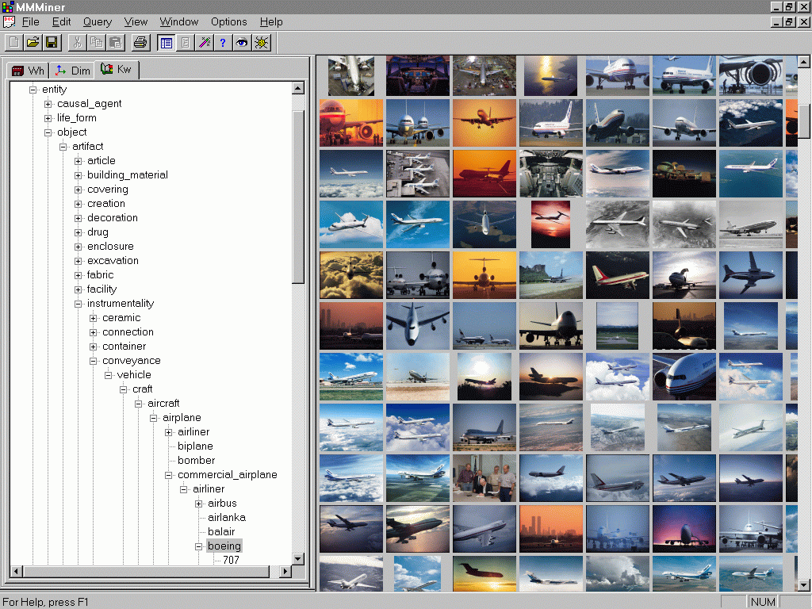
Mining Multimedia Databases in
MultiMediaMiner

Slide 30
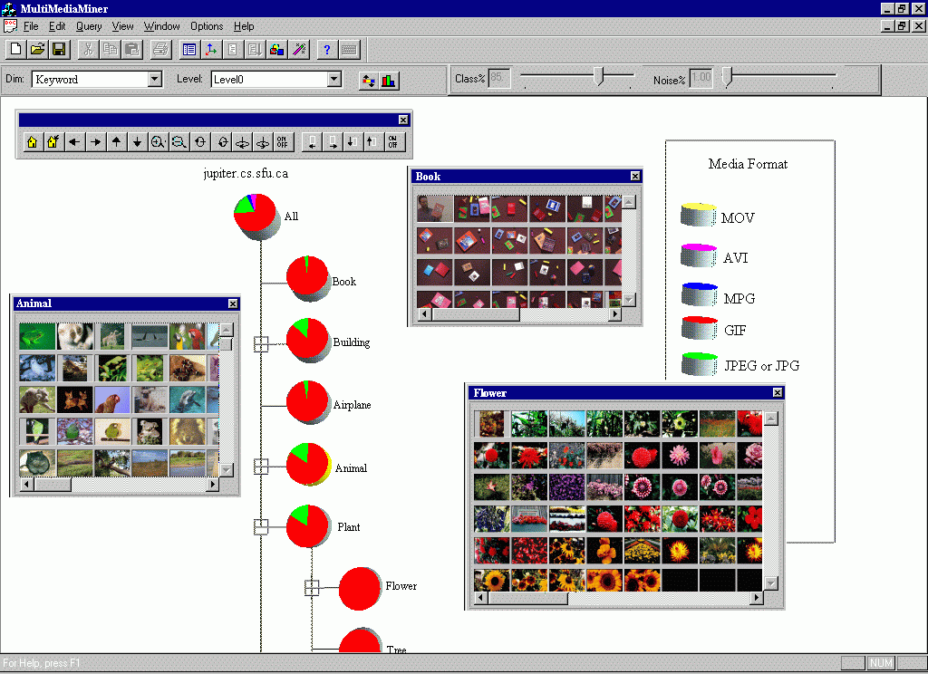
Classification in MultiMediaMiner

Slide 31
Mining Associations in Multimedia Data
Special features:
  Need # of occurrences besides Boolean existence, e.g.,
    “Two red square and one blue circle” implies theme “air-show”
  Need spatial relationships
    Blue on top of white squared object is associated with brown bottom
  Need multi-resolution and progressive refinement mining
    It is expensive to explore detailed associations among objects at high resolution
    It is crucial to ensure the completeness of search at multi-resolution space

Slide 32
Mining Multimedia Databases
Spatial Relationships from Layout
property P1 on-top-of property P2
property P1 next-to property P2
Different Resolution Hierarchy

Slide 33


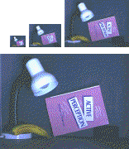
Mining Multimedia Databases
From Coarse to Fine Resolution Mining

Slide 34
Challenge: Curse of Dimensionality
Difficult to implement a data cube efficiently given a large number of dimensions, especially serious in the case of multimedia data cubes
Many of these attributes are set-oriented instead of single-valued
Restricting number of dimensions may lead to the modeling of an image at a rather rough, limited, and imprecise scale
More research is needed to strike a balance between efficiency and power of representation

Slide 35
Chapter 9. Mining Complex Types of Data
Mining spatial databases
Mining multimedia databases
Mining time-series and sequence data
Mining stream data
Mining text databases
Mining the World-Wide Web
Summary

Slide 36
Mining Time-Series and Sequence Data
Time-series database
  Consists of sequences of values or events changing with time
  Data is recorded at regular intervals
  Characteristic time-series components
    Trend, cycle, seasonal, irregular
Applications
  Financial: stock price, inflation
  Biomedical: blood pressure
  Meteorological: precipitation

Slide 37
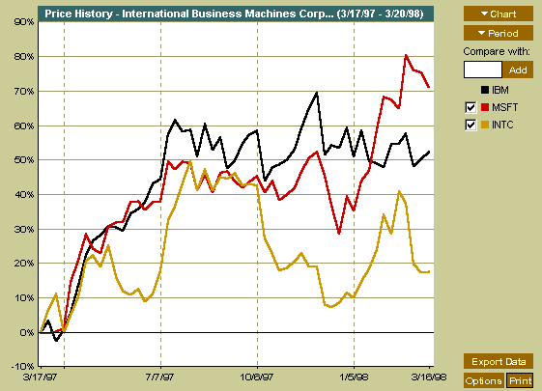
Mining Time-Series and Sequence Data
Time-series plot

Slide 38
Mining Time-Series and Sequence Data: Trend analysis
A time series can be illustrated as a time-series graph which describes a point moving with the passage of time
Categories of Time-Series Movements
  Long-term or trend movements (trend curve)
  Cyclic movements or cycle variations, e.g., business cycles
  Seasonal movements or seasonal variations
    i.e, almost identical patterns that a time series appears to follow during corresponding months of successive years.
  Irregular or random movements

Slide 39
Estimation of Trend Curve
The freehand method
  Fit the curve by looking at the graph
  Costly and barely reliable for large-scaled data mining
The least-square method
  Find the curve minimizing the sum of the squares of the deviation of points on the curve from the corresponding data points
The moving-average method
  Eliminate cyclic, seasonal and irregular patterns
  Loss of end data
  Sensitive to outliers

Slide 40
Discovery of Trend in Time-Series (1)
Estimation of seasonal variations
  Seasonal index
    Set of numbers showing the relative values of a variable during the months of the year
    E.g., if the sales during October, November, and December are 80%, 120%, and 140% of the average monthly sales for the whole year, respectively, then 80, 120, and 140 are seasonal index numbers for these months
  Deseasonalized data
    Data adjusted for seasonal variations
    E.g., divide the original monthly data by the seasonal index numbers for the corresponding months

Slide 41
Discovery of Trend in Time-Series (2)
Estimation of cyclic variations
  If (approximate) periodicity of cycles occurs, cyclic index can be constructed in much the same manner as seasonal indexes
Estimation of irregular variations
  By adjusting the data for trend, seasonal and cyclic variations
With the systematic analysis of the trend, cyclic, seasonal, and irregular components, it is possible to make long- or short-term predictions with reasonable quality

Slide 42
Similarity Search in Time-Series Analysis
Normal database query finds exact match
Similarity search finds data sequences that differ only slightly from the given query sequence
Two categories of similarity queries
  Whole matching: find a sequence that is similar to the query sequence
  Subsequence matching: find all pairs of similar sequences
Typical Applications
  Financial market
  Market basket data analysis
  Scientific databases
  Medical diagnosis

Slide 43
Data transformation
Many techniques for signal analysis require the data to be in the frequency domain
Usually data-independent transformations are used
  The transformation matrix is determined a priori
    E.g., discrete Fourier transform (DFT), discrete wavelet transform (DWT)
  The distance between two signals in the time domain is the same as their Euclidean distance in the frequency domain
  DFT does a good job of concentrating energy in the first few coefficients
  If we keep only first a few coefficients in DFT, we can compute the lower bounds of the actual distance

Slide 44
Multidimensional Indexing
Multidimensional index
  Constructed for efficient accessing using the first few Fourier coefficients
Use the index can to retrieve the sequences that are at most a certain small distance away from the query sequence
Perform post-processing by computing the actual distance between sequences in the time domain and discard any false matches

Slide 45
Subsequence Matching
Break each sequence into a set of pieces of window with length w
Extract the features of the subsequence inside the window
Map each sequence to a “trail” in the feature space
Divide the trail of each sequence into “subtrails” and represent each of them with minimum bounding rectangle
Use a multipiece assembly algorithm to search for longer sequence matches

Slide 46
Enhanced similarity search methods
Allow for gaps within a sequence or differences in offsets or amplitudes
Normalize sequences with amplitude scaling and offset translation
Two subsequences are considered similar if one lies within an envelope of ε width around the other, ignoring outliers
Two sequences are said to be similar if they have enough non-overlapping time-ordered pairs of similar subsequences
Parameters specified by a user or expert: sliding window size, width of an envelope for similarity, maximum gap, and matching fraction

Slide 47
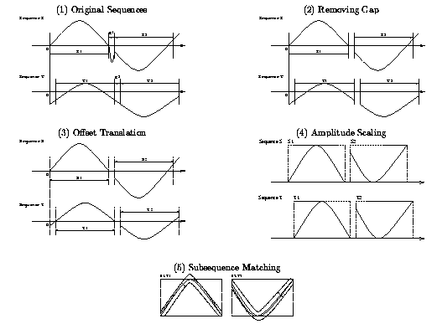
Similar time series analysis

Slide 48
Steps for Performing a Similarity Search
Atomic matching
  Find all pairs of gap-free windows of a small length that are similar
Window stitching
  Stitch similar windows to form pairs of large similar subsequences allowing gaps between atomic matches
Subsequence Ordering
  Linearly order the subsequence matches to determine whether enough similar pieces exist

Slide 49
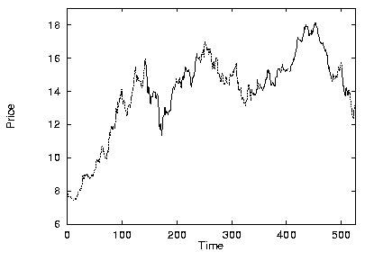
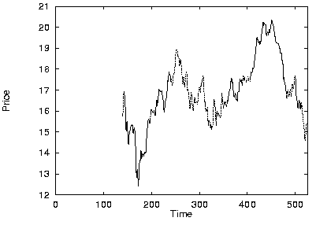
Similar time series analysis
VanEck International Fund
Fidelity Selective Precious Metal and Mineral Fund
Two similar mutual funds in the different fund group

Slide 50
Query Languages for Time Sequences
Time-sequence query language
  Should be able to specify sophisticated queries like
Find all of the sequences that are similar to some sequence in class A, but not similar to any sequence in class B
  Should be able to support various kinds of queries: range queries, all-pair queries, and nearest neighbor queries
Shape definition language
  Allows users to define and query the overall shape of time sequences
  Uses human readable series of sequence transitions or macros
  Ignores the specific details
    E.g., the pattern up, Up, UP can be used to describe increasing degrees of rising slopes
    Macros: spike, valley, etc.

Slide 51
Sequential Pattern Mining
Mining of frequently occurring patterns related to time or other sequences
Sequential pattern mining usually concentrate on symbolic patterns
Examples
  Renting “Star Wars”, then “Empire Strikes Back”, then “Return of the Jedi” in that order
  Collection of ordered events within an interval
Applications
  Targeted marketing
  Customer retention
  Weather prediction

Slide 52
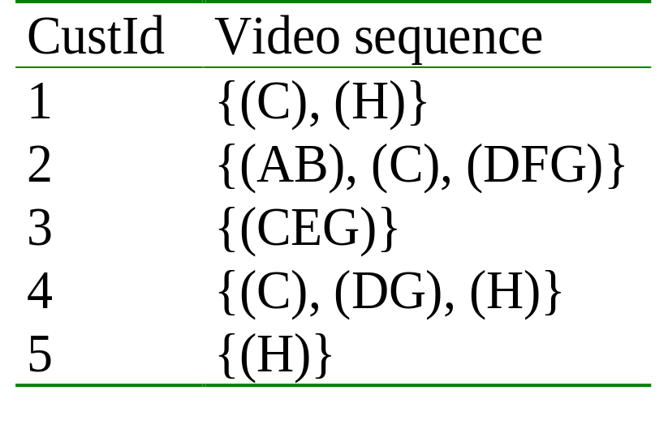
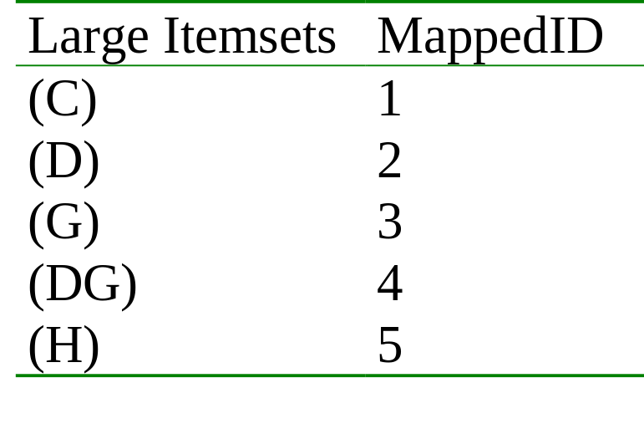
Mining Sequences (cont.)
Customer-sequence
Map Large Itemsets
Sequential patterns with support > 0.25
{(C), (H)}
{(C), (DG)}

Slide 53
Sequential pattern mining: Cases and Parameters
Duration of a time sequence T
  Sequential pattern mining can then be confined to the data within a specified duration
  Ex. Subsequence corresponding to the year of 1999
  Ex. Partitioned sequences, such as every year, or every week after stock crashes, or every two weeks before and after a volcano eruption
Event folding window w
  If w = T, time-insensitive frequent patterns are found
  If w = 0 (no event sequence folding), sequential patterns are found where each event occurs at a distinct time instant
  If 0 < w < T, sequences occurring within the same period w are folded in the analysis

Slide 54
Sequential pattern mining: Cases and Parameters (2)
Time interval, int, between events in the discovered pattern
  int = 0: no interval gap is allowed, i.e., only strictly consecutive sequences are found
    Ex. “Find frequent patterns occurring in consecutive weeks”
  min_int ≤ int ≤ max_int: find patterns that are separated by at least min_int but at most max_int
    Ex. “If a person rents movie A, it is likely she will rent movie B within 30 days” (int ≤ 30)
  int = c ≠ 0: find patterns carrying an exact interval
    Ex. “Every time when Dow Jones drops more than 5%, what will happen exactly two days later?” (int = 2)

Slide 55
Episodes and Sequential Pattern Mining Methods
Other methods for specifying the kinds of patterns
  Serial episodes: A → B
  Parallel episodes: A & B
  Regular expressions: (A | B)C*(D → E)
Methods for sequential pattern mining
  Variations of Apriori-like algorithms, e.g., GSP
  Database projection-based pattern growth
    Similar to the frequent pattern growth without candidate generation

Slide 56
Periodicity Analysis
Periodicity is everywhere: tides, seasons, daily power consumption, etc.
Full periodicity
  Every point in time contributes (precisely or approximately) to the periodicity
Partial periodicit: A more general notion
  Only some segments contribute to the periodicity
    Jim reads NY Times 7:00-7:30 am every week day
Cyclic association rules
  Associations which form cycles
Methods
  Full periodicity: FFT, other statistical analysis methods
  Partial and cyclic periodicity: Variations of Apriori-like mining methods

Slide 57
Chapter 9. Mining Complex Types of Data
Mining spatial databases
Mining multimedia databases
Mining time-series and sequence data
Mining stream data
Mining text databases
Mining the World-Wide Web
Summary

Slide 58
Chapter 9. Mining Complex Types of Data
Mining spatial databases
Mining multimedia databases
Mining time-series and sequence data
Mining stream data
Mining text databases
Mining the World-Wide Web
Summary

Slide 59
Text Databases and IR
Text databases (document databases)
  Large collections of documents from various sources: news articles, research papers, books, digital libraries, e-mail messages, and Web pages, library database, etc.
  Data stored is usually semi-structured
  Traditional information retrieval techniques become inadequate for the increasingly vast amounts of text data
Information retrieval
  A field developed in parallel with database systems
  Information is organized into (a large number of) documents
  Information retrieval problem: locating relevant documents based on user input, such as keywords or example documents

Slide 60
Information Retrieval
Typical IR systems
  Online library catalogs
  Online document management systems
Information retrieval vs. database systems
  Some DB problems are not present in IR, e.g., update, transaction management, complex objects
  Some IR problems are not addressed well in DBMS, e.g., unstructured documents, approximate search using keywords and relevance

Slide 61
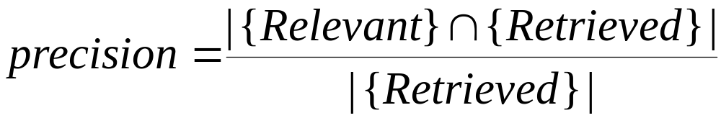
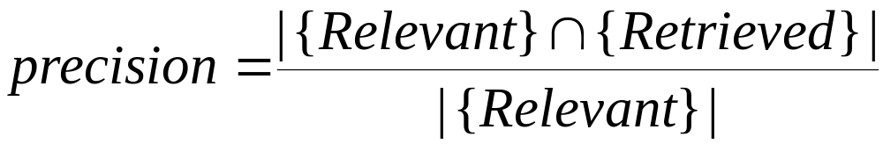
Basic Measures for Text Retrieval
Relevant
Relevant & Retrieved
Retrieved
All Documents
Precision: the percentage of retrieved documents that are in fact relevant to the query (i.e., “correct” responses)
Recall: the percentage of documents that are relevant to the query and were, in fact, retrieved

Slide 62
Information Retrieval Techniques(1)
Basic Concepts
  A document can be described by a set of representative keywords called index terms.
  Different index terms have varying relevance when used to describe document contents.
  This effect is captured through the assignment of numerical weights to each index term of a document. (e.g.: frequency, tf-idf)
DBMS Analogy
  Index Terms → Attributes
  Weights → Attribute Values

Slide 63
Information Retrieval Techniques(2)
Index Terms (Attribute) Selection:
  Stop list
  Word stem
  Index terms weighting methods
Terms  Documents Frequency Matrices
Information Retrieval Models:
  Boolean Model
  Vector Model
  Probabilistic Model

Slide 64
Boolean Model
Consider that index terms are either present or absent in a document
As a result, the index term weights are assumed to be all binaries
A query is composed of index terms linked by three connectives: not, and, and or
  e.g.: car and repair, plane or airplane
The Boolean model predicts that each document is either relevant or non-relevant based on the match of a document to the query

Slide 65
Boolean Model: Keyword-Based Retrieval
A document is represented by a string, which can be identified by a set of keywords
Queries may use expressions of keywords
  E.g., car and repair shop, tea or coffee, DBMS but not Oracle
  Queries and retrieval should consider synonyms, e.g., repair and maintenance
Major difficulties of the model
  Synonymy: A keyword T does not appear anywhere in the document, even though the document is closely related to T, e.g., data mining
  Polysemy: The same keyword may mean different things in different contexts, e.g., mining

Slide 66
Similarity-Based Retrieval in Text Databases
Finds similar documents based on a set of common keywords
Answer should be based on the degree of relevance based on the nearness of the keywords, relative frequency of the keywords, etc.
Basic techniques
Stop list
    Set of words that are deemed “irrelevant”, even though they may appear frequently
    E.g., a, the, of, for, to, with, etc.
    Stop lists may vary when document set varies

Slide 67
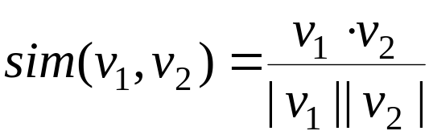
Similarity-Based Retrieval in Text Databases (2)
  Word stem
    Several words are small syntactic variants of each other since they share a common word stem
    E.g., drug, drugs, drugged
  A term frequency table
    Each entry frequent_table(i, j) = # of occurrences of the word t_{i} in document d_{i}
    Usually, the ratio instead of the absolute number of occurrences is used
  Similarity metrics: measure the closeness of a document to a query (a set of keywords)
    Relative term occurrences
    Cosine distance:

Slide 68
Indexing Techniques
Inverted index
  Maintains two hash- or B+-tree indexed tables:
    document_table: a set of document records <doc_id, postings_list>
    term_table: a set of term records, <term, postings_list>
  Answer query: Find all docs associated with one or a set of terms
  + easy to implement
  – do not handle well synonymy and polysemy, and posting lists could be too long (storage could be very large)
Signature file
  Associate a signature with each document
  A signature is a representation of an ordered list of terms that describe the document
  Order is obtained by frequency analysis, stemming and stop lists

Slide 69
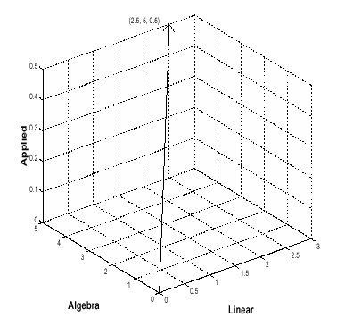
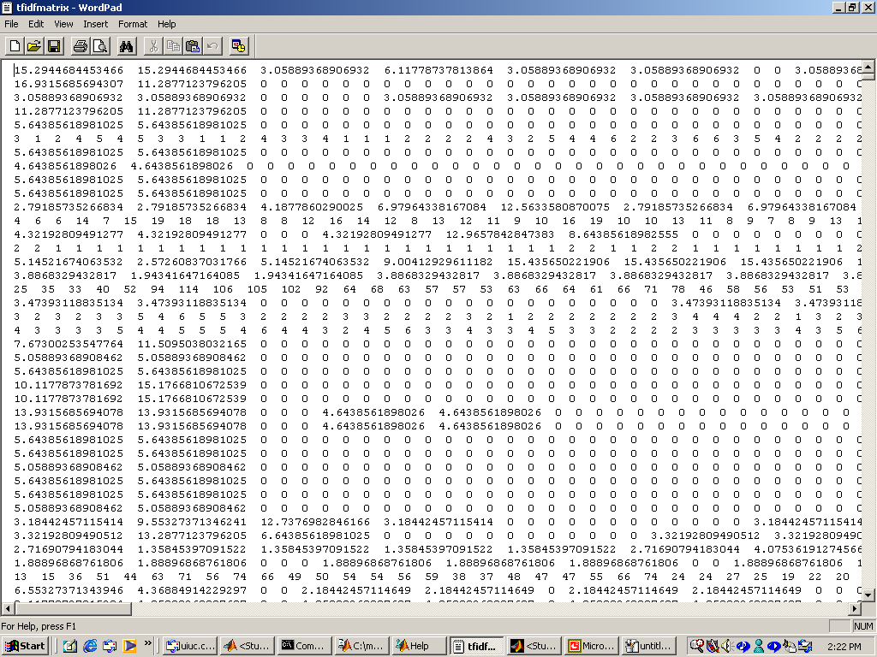
Vector Model
Documents and user queries are represented as m-dimensional vectors, where m is the total number of index terms in the document collection.
The degree of similarity of the document d with regard to the query q is calculated as the correlation between the vectors that represent them, using measures such as the Euclidian distance or the cosine of the angle between these two vectors.

Slide 70
Latent Semantic Indexing (1)
Basic idea
  Similar documents have similar word frequencies
  Difficulty: the size of the term frequency matrix is very large
  Use a singular value decomposition (SVD) techniques to reduce the size of frequency table
  Retain the K most significant rows of the frequency table
Method
  Create a term x document weighted frequency matrix A
  SVD construction: A = U * S * V’
  Define K and obtain U_{k} ,, S_{k} , and V_{k}.
  Create query vector q’ .
  Project q’ into the term-document space: Dq = q’ * U_{k} * S_{k}⁻¹
  Calculate similarities: cos α = Dq . D / ||Dq|| * ||D||

Slide 71
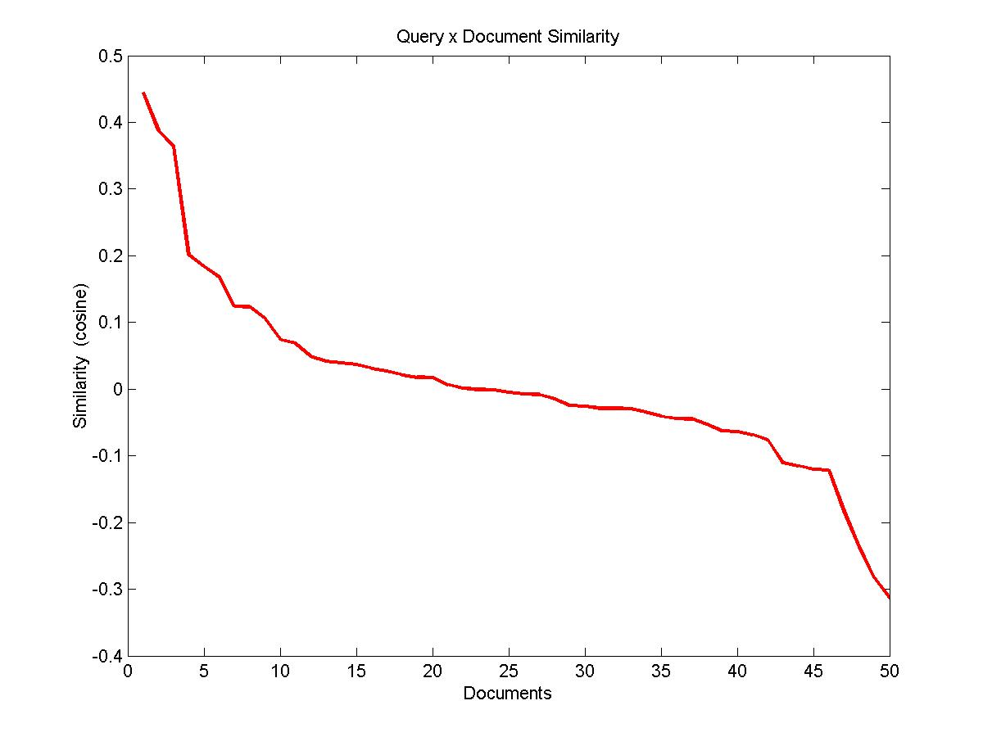

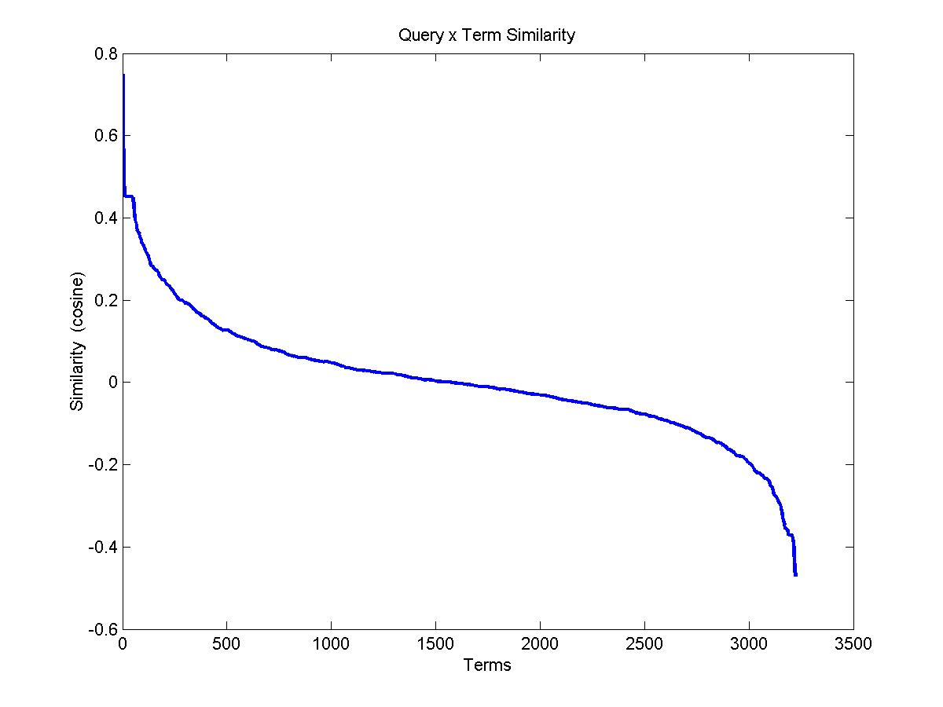
Latent Semantic Indexing (2)
Weighted Frequency Matrix
Query Terms:
- Insulation
- Joint

Slide 72
Probabilistic Model
Basic assumption: Given a user query, there is a set of documents which contains exactly the relevant documents and no other (ideal answer set)
Querying process as a process of specifying the properties of an ideal answer set. Since these properties are not known at query time, an initial guess is made
This initial guess allows the generation of a preliminary probabilistic description of the ideal answer set which is used to retrieve the first set of documents
An interaction with the user is then initiated with the purpose of improving the probabilistic description of the answer set

Slide 73
Types of Text Data Mining
Keyword-based association analysis
Automatic document classification
Similarity detection
  Cluster documents by a common author
  Cluster documents containing information from a common source
Link analysis: unusual correlation between entities
Sequence analysis: predicting a recurring event
Anomaly detection: find information that violates usual patterns
Hypertext analysis
  Patterns in anchors/links
    Anchor text correlations with linked objects

Slide 74
Keyword-Based Association Analysis
Motivation
  Collect sets of keywords or terms that occur frequently together and then find the association or correlation relationships among them
Association Analysis Process
  Preprocess the text data by parsing, stemming, removing stop words, etc.
  Evoke association mining algorithms
    Consider each document as a transaction
    View a set of keywords in the document as a set of items in the transaction
  Term level association mining
    No need for human effort in tagging documents
    The number of meaningless results and the execution time is greatly reduced

Slide 75
Text Classification(1)
Motivation
  Automatic classification for the large number of on-line text documents (Web pages, e-mails, corporate intranets, etc.)
Classification Process
  Data preprocessing
  Definition of training set and test sets
  Creation of the classification model using the selected classification algorithm
  Classification model validation
  Classification of new/unknown text documents
Text document classification differs from the classification of relational data
  Document databases are not structured according to attribute-value pairs

Slide 76
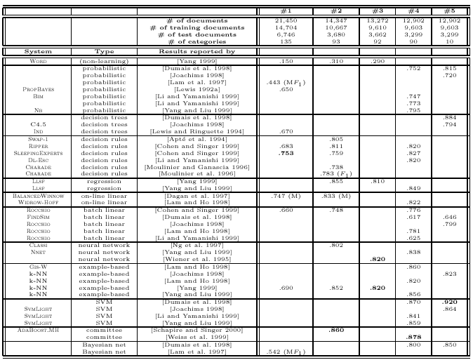
Text Classification(2)
Classification Algorithms:
  Support Vector Machines
  K-Nearest Neighbors
  Naïve Bayes
  Neural Networks
  Decision Trees
  Association rule-based
  Boosting

Slide 77
Document Clustering
Motivation
  Automatically group related documents based on their contents
  No predetermined training sets or taxonomies
  Generate a taxonomy at runtime
Clustering Process
  Data preprocessing: remove stop words, stem, feature extraction, lexical analysis, etc.
  Hierarchical clustering: compute similarities applying clustering algorithms.
  Model-Based clustering (Neural Network Approach): clusters are represented by “exemplars”. (e.g.: SOM)

Slide 78
Chapter 9. Mining Complex Types of Data
Mining spatial databases
Mining multimedia databases
Mining time-series and sequence data
Mining stream data
Mining text databases
Mining the World-Wide Web
Summary

Slide 79
Mining the World-Wide Web
The WWW is huge, widely distributed, global information service center for
  Information services: news, advertisements, consumer information, financial management, education, government, e-commerce, etc.
  Hyper-link information
  Access and usage information
WWW provides rich sources for data mining
Challenges
  Too huge for effective data warehousing and data mining
  Too complex and heterogeneous: no standards and structure

Slide 80
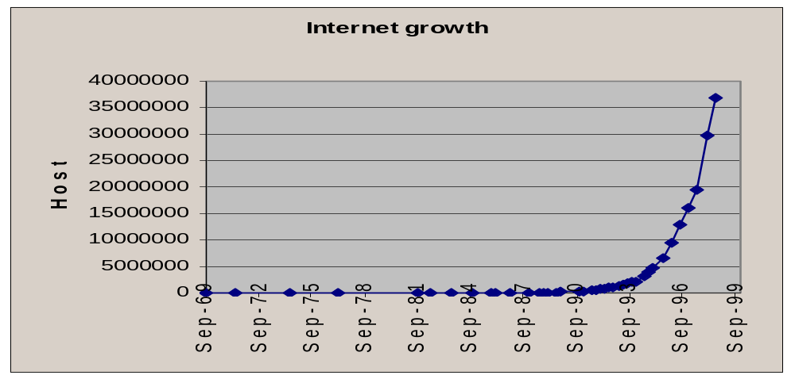
Mining the World-Wide Web
Growing and changing very rapidly
Broad diversity of user communities
Only a small portion of the information on the Web is truly relevant or useful
  99% of the Web information is useless to 99% of Web users
  How can we find high-quality Web pages on a specified topic?

Slide 81
Web search engines
Index-based: search the Web, index Web pages, and build and store huge keyword-based indices
Help locate sets of Web pages containing certain keywords
Deficiencies
  A topic of any breadth may easily contain hundreds of thousands of documents
  Many documents that are highly relevant to a topic may not contain keywords defining them (polysemy)

Slide 82
Web Mining: A more challenging task
Searches for
  Web access patterns
  Web structures
  Regularity and dynamics of Web contents
Problems
  The “abundance” problem
  Limited coverage of the Web: hidden Web sources, majority of data in DBMS
  Limited query interface based on keyword-oriented search
  Limited customization to individual users

Slide 83
Web Mining Taxonomy
Web Mining
Web Content
Mining
Web Structure
Mining
Web Usage
Mining
Web Page
Content Mining
Search Result
Mining
General Access
Pattern Tracking
Customized
Usage Tracking

Slide 84
Mining the World-Wide Web
Web Mining
Web Content
Mining
Web Structure
Mining
Web Usage
Mining
Web Page Content Mining
Web Page Summarization
WebLog (Lakshmanan et.al. 1996), WebOQL(Mendelzon et.al. 1998) …:
Web Structuring query languages;
Can identify information within given web pages
Ahoy! (Etzioni et.al. 1997):Uses heuristics to distinguish personal home pages from other web pages
ShopBot (Etzioni et.al. 1997): Looks for product prices within web pages
Search Result
Mining
General Access
Pattern Tracking
Customized
Usage Tracking

Slide 85
Mining the World-Wide Web
Web Mining
Web Content
Mining
Web Structure
Mining
Web Usage
Mining
Web Page
Content Mining
Search Result Mining
Search Engine Result Summarization
Clustering Search Result (Leouski and Croft, 1996, Zamir and Etzioni, 1997):
Categorizes documents using phrases in titles and snippets
General Access
Pattern Tracking
Customized
Usage Tracking

Slide 86
Mining the World-Wide Web
Web Mining
Web Content
Mining
Web Usage
Mining
Web Structure Mining
Using Links
PageRank (Brin et al., 1998)
CLEVER (Chakrabarti et al., 1998)
Use interconnections between web pages to give weight to pages.
Using Generalization
MLDB (1994), VWV (1998)
Uses a multi-level database representation of the Web. Counters (popularity) and link lists are used for capturing structure.
Search Result
Mining
General Access
Pattern Tracking
Web Page
Content Mining
Customized
Usage Tracking

Slide 87
Mining the World-Wide Web
Web Mining
Web Content
Mining
Web Structure
Mining
Web Usage
Mining
Web Page
Content Mining
General Access Pattern Tracking
Web Log Mining (Zaïane, Xin and Han, 1998)
Uses KDD techniques to understand general access patterns and trends.
Can shed light on better structure and grouping of resource providers.
Customized
Usage Tracking
Search Result
Mining

Slide 88
Mining the World-Wide Web
Web Mining
Web Content
Mining
Web Structure
Mining
Web Usage
Mining
Web Page
Content Mining
General Access
Pattern Tracking
Customized Usage Tracking
Adaptive Sites (Perkowitz and Etzioni, 1997)
Analyzes access patterns of each user at a time.
Web site restructures itself automatically by learning from user access patterns.
Search Result
Mining

Slide 89
Mining the Web's Link Structures
Finding authoritative Web pages
  Retrieving pages that are not only relevant, but also of high quality, or authoritative on the topic
Hyperlinks can infer the notion of authority
  The Web consists not only of pages, but also of hyperlinks pointing from one page to another
  These hyperlinks contain an enormous amount of latent human annotation
  A hyperlink pointing to another Web page, this can be considered as the author's endorsement of the other page

Slide 90
Mining the Web's Link Structures
Problems with the Web linkage structure
  Not every hyperlink represents an endorsement
    Other purposes are for navigation or for paid advertisements
    If the majority of hyperlinks are for endorsement, the collective opinion will still dominate
  One authority will seldom have its Web page point to its rival authorities in the same field
  Authoritative pages are seldom particularly descriptive
Hub
  Set of Web pages that provides collections of links to authorities

Slide 91
HITS (Hyperlink-Induced Topic Search)
Explore interactions between hubs and authoritative pages
Use an index-based search engine to form the root set
  Many of these pages are presumably relevant to the search topic
  Some of them should contain links to most of the prominent authorities
Expand the root set into a base set
  Include all of the pages that the root-set pages link to, and all of the pages that link to a page in the root set, up to a designated size cutoff
Apply weight-propagation
  An iterative process that determines numerical estimates of hub and authority weights

Slide 92
Systems Based on HITS
  Output a short list of the pages with large hub weights, and the pages with large authority weights for the given search topic
Systems based on the HITS algorithm
  Clever, Google: achieve better quality search results than those generated by term-index engines such as AltaVista and those created by human ontologists such as Yahoo!
Difficulties from ignoring textual contexts
  Drifting: when hubs contain multiple topics
  Topic hijacking: when many pages from a single Web site point to the same single popular site

Slide 93
Automatic Classification of Web Documents
Assign a class label to each document from a set of predefined topic categories
Based on a set of examples of preclassified documents
Example
  Use Yahoo!'s taxonomy and its associated documents as training and test sets
  Derive a Web document classification scheme
  Use the scheme classify new Web documents by assigning categories from the same taxonomy
Keyword-based document classification methods
Statistical models

Slide 94
Multilayered Web Information Base
Layer₀: the Web itself
Layer₁: the Web page descriptor layer
  Contains descriptive information for pages on the Web
  An abstraction of Layer₀: substantially smaller but still rich enough to preserve most of the interesting, general information
  Organized into dozens of semistructured classes
    document, person, organization, ads, directory, sales, software, game, stocks, library_catalog, geographic_data, scientific_data, etc.
Layer₂ and up: various Web directory services constructed on top of Layer₁
  provide multidimensional, application-specific services

Slide 95







Multiple Layered Web Architecture
More Generalized Descriptions
Layer_{n}
...
Generalized Descriptions
Layer₁
Layer₀

Slide 96
Mining the World-Wide Web
Layer-0: Primitive data
Layer-1: dozen database relations representing types of objects (metadata)
document, organization, person, software, game, map, image,…
document(file_addr, authors, title, publication, publication_date, abstract, language, table_of_contents, category_description, keywords, index, multimedia_attached, num_pages, format, first_paragraphs, size_doc, timestamp, access_frequency, links_out,...)
person(last_name, first_name, home_page_addr, position, picture_attached, phone, e-mail, office_address, education, research_interests, publications, size_of_home_page, timestamp, access_frequency, ...)
image(image_addr, author, title, publication_date, category_description, keywords, size, width, height, duration, format, parent_pages, colour_histogram, Colour_layout, Texture_layout, Movement_vector, localisation_vector, timestamp, access_frequency, ...)

Slide 97
Mining the World-Wide Web
Layer-2: simplification of layer-1
doc_brief(file_addr, authors, title, publication, publication_date, abstract, language, category_description, key_words, major_index, num_pages, format, size_doc, access_frequency, links_out)
person_brief (last_name, first_name, publications,affiliation, e-mail, research_interests, size_home_page, access_frequency)
Layer-3: generalization of layer-2
cs_doc(file_addr, authors, title, publication, publication_date, abstract, language, category_description, keywords, num_pages, form, size_doc, links_out)
doc_summary(affiliation, field, publication_year, count, first_author_list, file_addr_list)
doc_author_brief(file_addr, authors, affiliation, title, publication, pub_date, category_description, keywords, num_pages, format, size_doc, links_out)
person_summary(affiliation, research_interest, year, num_publications, count)

Slide 98
XML and Web Mining
XML can help to extract the correct descriptors
  Standardization would greatly facilitate information extraction
  Potential problem
    XML can help solve heterogeneity for vertical applications, but the freedom to define tags can make horizontal applications on the Web more heterogeneous
<NAME> eXtensible Markup Language</NAME>
<RECOM>World-Wide Web Consortium</RECOM>
<SINCE>1998</SINCE>
<VERSION>1.0</VERSION>
<DESC>Meta language that facilitates more meaningful and precise declarations of document content</DESC>
<HOW>Definition of new tags and DTDs</HOW>

Slide 99
Benefits of Multi-Layer Meta-Web
Benefits:
  Multi-dimensional Web info summary analysis
  Approximate and intelligent query answering
  Web high-level query answering (WebSQL, WebML)
  Web content and structure mining
  Observing the dynamics/evolution of the Web
Is it realistic to construct such a meta-Web?
  Benefits even if it is partially constructed
  Benefits may justify the cost of tool development, standardization and partial restructuring

Slide 100
Web Usage Mining
Mining Web log records to discover user access patterns of Web pages
Applications
  Target potential customers for electronic commerce
  Enhance the quality and delivery of Internet information services to the end user
  Improve Web server system performance
  Identify potential prime advertisement locations
Web logs provide rich information about Web dynamics
  Typical Web log entry includes the URL requested, the IP address from which the request originated, and a timestamp

Slide 101
Techniques for Web usage mining
Construct multidimensional view on the Weblog database
  Perform multidimensional OLAP analysis to find the top N users, top N accessed Web pages, most frequently accessed time periods, etc.
Perform data mining on Weblog records
  Find association patterns, sequential patterns, and trends of Web accessing
  May need additional information,e.g., user browsing sequences of the Web pages in the Web server buffer
Conduct studies to
  Analyze system performance, improve system design by Web caching, Web page prefetching, and Web page swapping

Slide 102




Mining the World-Wide Web
Design of a Web Log Miner
  Web log is filtered to generate a relational database
  A data cube is generated form database
  OLAP is used to drill-down and roll-up in the cube
  OLAM is used for mining interesting knowledge
Knowledge
Web log
Database
Data Cube
Sliced and diced
cube
1
Data Cleaning
2
Data Cube
Creation
3
OLAP
4
Data Mining

Slide 103
Chapter 9. Mining Complex Types of Data
Mining spatial databases
Mining multimedia databases
Mining time-series and sequence data
Mining stream data
Mining text databases
Mining the World-Wide Web
Summary

Slide 104
Summary (1)
Mining complex types of data include object data, spatial data, multimedia data, time-series data, text data, and Web data
Object data can be mined by multi-dimensional generalization of complex structured data, such as plan mining for flight sequences
Spatial data warehousing, OLAP and mining facilitates multidimensional spatial analysis and finding spatial associations, classifications and trends
Multimedia data mining needs content-based retrieval and similarity search integrated with mining methods

Slide 105
Summary (2)
Time-series/sequential data mining includes trend analysis, similarity search in time series, mining sequential patterns and periodicity in time sequence
Text mining goes beyond keyword-based and similarity-based information retrieval and discovers knowledge from semi-structured data using methods like keyword-based association and document classification
Web mining includes mining Web link structures to identify authoritative Web pages, the automatic classification of Web documents, building a multilayered Web information base, and Weblog mining

Slide 106
References (1)
R. Agrawal, C. Faloutsos, and A. Swami. Efficient similarity search in sequence databases. In Proc. 4th Int. Conf. Foundations of Data Organization and Algorithms, Chicago, Oct. 1993.
R. Agrawal, K.-I. Lin, H.S. Sawhney, and K. Shim. Fast similarity search in the presence of noise, scaling, and translation in time-series databases. VLDB'95, Zurich, Switzerland, Sept. 1995.
G. Arocena and A. O. Mendelzon. WebOQL : Restructuring documents, databases, and webs. ICDE'98, Orlando, FL, Feb. 1998.
R. Agrawal, G. Psaila, E. L. Wimmers, and M. Zait. Querying shapes of histories. VLDB'95, Zurich, Switzerland, Sept. 1995.
R. Agrawal and R. Srikant. Mining sequential patterns. ICDE'95, Taipei, Taiwan, Mar. 1995.
S. Brin and L. Page. The anatomy of a large-scale hypertextual web search engine. WWW'98, Brisbane, Australia, 1998.
C. Bettini, X. Sean Wang, and S. Jajodia. Mining temporal relationships with multiple granularities in time sequences. Data Engineering Bulletin, 21:32-38, 1998.
R. Baeza-Yates and B. Ribeiro-Neto. Modern Information Retrieval. Addison-Wesley, 1999.
S. Chakrabarti, B. E. Dom, and P. Indyk. Enhanced hypertext classification using hyper-links. SIGMOD'98, Seattle, WA, June 1998.
S. Chakrabarti, B. E. Dom, S. R. Kumar, P. Raghavan, S. Rajagopalan, A. Tomkins, D. Gibson, and J. M. Kleinberg. Mining the web's link structure. COMPUTER, 32:60-67, 1999.

Slide 107
References (2)
J. Chen, D. DeWitt, F. Tian, and Y. Wang. NiagraCQ: A scalable continuous query system for internet databases. SIGMOD'00, Dallas, TX, May 2000.
C. Chatfield. The Analysis of Time Series: An Introduction, 3rd ed. Chapman and Hall, 1984.
S. Chakrabarti. Data mining for hypertex: A tutorial survey. SIGKDD Explorations, 1:1-11, 2000.
S. Deerwester, S. Dumais, G. Furnas, T. Landauer, and R. Harshman. Indexing by latent semantic analysis. J. American Society for Information Science, 41:391-407, 1990.
M. Ester, A. Frommelt, H.-P. Kriegel, and J. Sander. Algorithms for claracterization and trend detection in spatial databases. KDD'98, New York, NY, Aug. 1998.
M.J. Egenhofer. Spatial Query Languages. UMI Research Press, University of Maine, Portland, Maine, 1989.
M. Ester, H.-P. Kriegel, and J. Sander. Spatial data mining: A database approach. SSD'97, Berlin, Germany, July 1997.
C. Faloutsos. Access methods for text. ACM Comput. Surv., 17:49-74, 1985.
U. M. Fayyad, S. G. Djorgovski, and N. Weir. Automating the analysis and cataloging of sky surveys. In U.M. Fayyad, G. Piatetsky-Shapiro, P. Smyth, and R. Uthurusamy, editors, Advances in Knowledge Discovery and Data Mining, AAAI/MIT Press, 1996.
R. Feldman and H. Hirsh. Finding associations in collectionds of text. In R. S. Michalski, I. Bratko, and M. Kubat, editors, "Machine Learning and Data Mining: Methods and Applications", John Wiley Sons, 1998.

Slide 108
References (3)
C. Faloutsos and K.-I. Lin. FastMap: A fast algorithm for indexing, data-mining and visualization of traditional and multimedia datasets. SIGMOD'95, San Jose, CA, May 1995.
D. Florescu, A. Y. Levy, and A. O. Mendelzon. Database techniques for the world-wide web: A survey. SIGMOD Record, 27:59-74, 1998.
U. M. Fayyad, G. Piatetsky-Shapiro, P. Smyth, and R. Uthurusamy (eds.). Advances in Knowledge Discovery and Data Mining. AAAI/MIT Press, 1996.
C. Faloutsos, M. Ranganathan, and Y. Manolopoulos. Fast subsequence matching in time-series databases. SIGMOD'94, Minneapolis, Minnesota, May 1994.
M. Flickner, H. Sawhney, W. Niblack, J. Ashley, B. Dom, Q. Huang, M. Gorkani, J. Hafner, D. Lee, D. Petkovic, S. Steele, and P. Yanker. Query by image and video content: The QBIC system. IEEE Computer, 28:23-32, 1995.
S. Guha, R. Rastogi, and K. Shim. Rock: A robust clustering algorithm for categorical attributes. ICDE'99, Sydney, Australia, Mar. 1999.
R. H. Gueting. An introduction to spatial database systems. The VLDB Journal, 3:357-400, 1994.
J. Han, G. Dong, and Y. Yin. Efficient mining of partial periodic patterns in time series database. ICDE'99, Sydney, Australia, Apr. 1999.
J. Han, K. Koperski, and N. Stefanovic. GeoMiner: A system prototype for spatial data mining. SIGMOD'97, Tucson, Arizona, May 1997.

Slide 109
References (4)
J. Han, S. Nishio, H. Kawano, and W. Wang. Generalization-based data mining in object-oriented databases using an object-cube model. Data and Knowledge Engineering, 25:55-97, 1998.
J. Han, J. Pei, B. Mortazavi-Asl, Q. Chen, U. Dayal, and M.-C. Hsu. Freespan: Frequent pattern-projected sequential pattern mining. KDD'00, Boston, MA, Aug. 2000.
J. Han, N. Stefanovic, and K. Koperski. Selective materialization: An efficient method for spatial data cube construction. PAKDD'98. Melbourne, Australia, Apr. 1998.
J. Han, Q. Yang, and E. Kim. Plan mining by divide-and-conquer. DMKD'99, Philadelphia, PA, May 1999.
K. Koperski and J. Han. Discovery of spatial association rules in geographic information databases. SSD'95, Portland, Maine, Aug. 1995.
J. M. Kleinberg. Authoritative sources in a hyperlinked environment. Journal of ACM, 46:604-632, 1999.
E. Knorr and R. Ng. Finding aggregate proximity relationships and commonalities in spatial data mining. IEEE Trans. Knowledge and Data Engineering, 8:884-897, 1996.
J. M. Kleinberg and A. Tomkins. Application of linear algebra in information retrieval and hypertext analysis. PODS'99. Philadelphia, PA, May 1999.
H. Lu, J. Han, and L. Feng. Stock movement and n-dimensional inter-transaction association rules. DMKD'98, Seattle, WA, June 1998.

Slide 110
References (5)
W. Lu, J. Han, and B. C. Ooi. Knowledge discovery in large spatial databases. In Proc. Far East Workshop Geographic Information Systems, Singapore, June 1993.
D. J. Maguire, M. Goodchild, and D. W. Rhind. Geographical Information Systems: Principles and Applications. Longman, London, 1992.
H. Miller and J. Han. Geographic Data Mining and Knowledge Discovery. Taylor and Francis, 2000.
A. O. Mendelzon, G. A. Mihaila, and T. Milo. Querying the world-wide web. Int. Journal of Digital Libraries, 1:54-67, 1997.
H. Mannila, H Toivonen, and A. I. Verkamo. Discovery of frequent episodes in event sequences. Data Mining and Knowledge Discovery, 1:259-289, 1997.
A. Natsev, R. Rastogi, and K. Shim. Walrus: A similarity retrieval algorithm for image databases. SIGMOD'99, Philadelphia, PA, June 1999.
B. Ozden, S. Ramaswamy, and A. Silberschatz. Cyclic association rules. ICDE'98, Orlando, FL, Feb. 1998.
M. Perkowitz and O. Etzioni. Adaptive web sites: Conceptual cluster mining. IJCAI'99, Stockholm, Sweden, 1999.
P. Raghavan. Information retrieval algorithms: A survey. In Proc. 1997 ACM-SIAM Symp. Discrete Algorithms, New Orleans, Louisiana, 1997.

Slide 111
References (6)
D. Rafiei and A. Mendelzon. Similarity-based queries for time series data. SIGMOD'97, Tucson, Arizona, May 1997.
G. Salton. Automatic Text Processing. Addison-Wesley, 1989.
J. Srivastava, R. Cooley, M. Deshpande, and P. N. Tan. Web usage mining: Discovery and applications of usage patterns from web data. SIGKDD Explorations, 1:12-23, 2000.
P. Stolorz and C. Dean. Quakefinder: A scalable data mining system for detecting earthquakes from space. KDD'96, Portland, Oregon, Aug. 1996.
G. Salton and M. McGill. Introduction to Modern Information Retrieval. McGraw-Hill, 1983.
V. S. Subrahmanian. Principles of Multimedia Database Systems. Morgan Kaufmann, 1998.
C. J. van Rijsbergen. Information Retrieval. Butterworth, 1990.
K. Wang, S. Zhou, and S. C. Liew. Building hierarchical classifiers using class proximity. VLDB'99, Edinburgh, UK, Sept. 1999.
B.-K. Yi, H. V. Jagadish, and C. Faloutsos. Efficient retrieval of similar time sequences under time warping. ICDE'98, Orlando, FL, Feb. 1998.
C. T. Yu and W. Meng. Principles of Database Query Processing for Advanced Applications. Morgan Kaufmann, 1997.

Slide 112
References (7)
B.-K. Yi, N. Sidiropoulos, T. Johnson, H. V. Jagadish, C. Faloutsos, and A. Biliris. Online data mining for co-evolving time sequences. ICDE'00, San Diego, CA, Feb. 2000.
C. Zaniolo, S. Ceri, C. Faloutsos, R. T. Snodgrass, C. S. Subrahmanian, and R. Zicari. Advanced Database Systems. Morgan Kaufmann, 1997.
O. R. Za"iane and J. Han. Resource and knowledge discovery in global information systems: A preliminary design and experiment. KDD'95, Montreal, Canada, Aug. 1995.
O. R. Za"iane and J. Han. WebML : Querying the world-wide web for resources and knowledge. WIDM'98, Bethesda, Maryland, Nov. 1998.
O. R. Za"iane, J. Han, Z. N. Li, J. Y. Chiang, and S. Chee. MultiMedia-Miner: A system prototype for multimedia data mining. SIGMOD'98, Seattle, WA, June 1998.
O. R. Za"iane, J. Han, and H. Zhu. Mining recurrent items in multimedia with progressive resolution refinement. ICDE'00, San Diego, CA, Feb. 2000.
M. J. Zaki, N. Lesh, and M. Ogihara. PLANMINE: Sequence mining for plan failures. KDD'98, New York, NY, Aug. 1998.
X. Zhou, D. Truffet, and J. Han. Efficient polygon amalgamation methods for spatial OLAP and spatial data mining. SSD'99. Hong Kong, July 1999.
O. R. Za"iane, M. Xin, and J. Han. Discovering Webaccess patterns and trends by applying OLAP and data mining technology on Web logs. ADL'98, Santa Barbara, CA, Apr. 1998.

Slide 113
Some References on Spatial Data Mining
H. Miller and J. Han (eds.), Geographic Data Mining and Knowledge Discovery, Taylor and Francis, 2001.
Ester M., Frommelt A., Kriegel H.-P., Sander J.: Spatial Data Mining: Database Primitives, Algorithms and Efficient DBMS Support, Data Mining and Knowledge Discovery, an International Journal. 4, 2000, pp. 193-216.
J. Han, M. Kamber, and A. K. H. Tung, "Spatial Clustering Methods in Data Mining: A Survey", in H. Miller and J. Han (eds.), Geographic Data Mining and Knowledge Discovery, Taylor and Francis, 2000.
Y. Bedard, T. Merrett, and J. Han, "Fundamentals of Geospatial Data Warehousing for Geographic Knowledge Discovery", in H. Miller and J. Han (eds.), Geographic Data Mining and Knowledge Discovery, Taylor and Francis, 2000

Slide 114
References on Text Mining (1)
G. Arocena and A. O. Mendelzon. WebOQL : Restructuring documents, databases, and webs. ICDE'98, Orlando, FL, Feb. 1998.
R. Baeza-Yates and B. Ribeiro-Neto. Modern Information Retrieval. Addison-Wesley, 1999.
S. Deerwester, S. Dumais, G. Furnas, T. Landauer, and R. Harshman. Indexing by latent semantic analysis. J. American Society for Information Science, 41:391-407, 1990.
C. Faloutsos. Access methods for text. ACM Comput. Surv., 17:49-74, 1985.
R. Feldman and H. Hirsh. Finding associations in collectionds of text. In R. S. Michalski, I. Bratko, and M. Kubat, editors, "Machine Learning and Data Mining: Methods and Applications", John Wiley Sons, 1998.
J. M. Kleinberg and A. Tomkins. Application of linear algebra in information retrieval and hypertext analysis. PODS'99. Philadelphia, PA, May 1999.
P. Raghavan. Information retrieval algorithms: A survey. In Proc. 1997 ACM-SIAM Symp. Discrete Algorithms, New Orleans, Louisiana, 1997.

Slide 115
References on Text Mining (1)
C. J. van Rijsbergen. Information Retrieval. Butterworth, 1990.
G. Salton. Automatic Text Processing. Addison-Wesley, 1989.
G. Salton and M. McGill. Introduction to Modern Information Retrieval. McGraw-Hill, 1983.
F. Sebastiani. Machine learning in automated text categorization. ACM Computing Surveys. Accepted for publication, 2002.
K. Wang, S. Zhou, and S. C. Liew. Building hierarchical classifiers using class proximity. VLDB'99, Edinburgh, UK, Sept. 1999.
Y. Yang and X. Liu. A re-examination of text categorization methods. Proceedings of ACM SIGIR Conference on Research and Development in Information Retrieval (SIGIR'99, pp 42--49), 1999.
Y. Yang. An evaluation of statistical approaches to text categorization. Journal of Information Retrieval, Vol 1, No. 1/2, pp 67--88, 1999.

Slide 116

www.cs.uiuc.edu/~hanj
Thank you !!!

